Slide 1
From Network Traffic Measurements to QoE for Internet Video
ARBAI Safaa
MADEIRA DE CARVALHO Martim
LE Phuc Lai

Slide 2
Table of Contents
The Dataset
Data Exploration
Stall detection
Startup delay classification
Startup delay prediction
QoE score prediction

Slide 3
Purpose
Video Traffic are encrypted (HTTP, QUIC).
Network operator can only have access to Quality of Service (QoS) signals like throughput, packet sizes, loss, jitter, etc.
Goals: Can we predict user-perceived Quality of Experience (QoE), and other QoS metrics that affect QoE (stall, join_time, etc.) from network and packet level data?

Slide 4
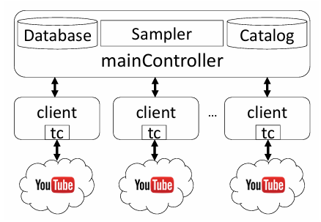
The Dataset
Trace-based sampling: use real life network trace (RTR-NetzTest, MobiPerf)
Testbed: Grid5000 and R2Lab platforms, controller on EC2
Data Collection Process: Client enforce QoS condition using tc, video is played on Chrome browse
Feature extraction:
Network Layer: Statistical features were gathered from encrypted packet traces: throughput, interarrival time
Application Layer: HTTP traces and the YouTube API were used to record "ground truth" QoE metrics: startup delay, stalls, resolution changes.
Ground Truth Labeling (Subjective MOS): ITU-T P.1203
The experimentation framework
From Network Traffic Measurements to QoE for Internet Video | IEEE Conference Publication | IEEE Xplore

Slide 5
The Dataset
F_inband: 48 features
Encrypted packet traces, include the statistical metrics of the downlink throughput (bps), the uplink and downlink interarrival times (s) and the downlink packet sizes (bytes).
F_chunks: 7 features
Chunk information from encrypted traffic. Composed of the the statistical metrics of the chunk sizes array
F_outband: 5 features
The feature that are configured on tc
Target: ITU_QoE, join time, average resolution, stalling, startup delay, quality switch
Other feature: Video category

Slide 6
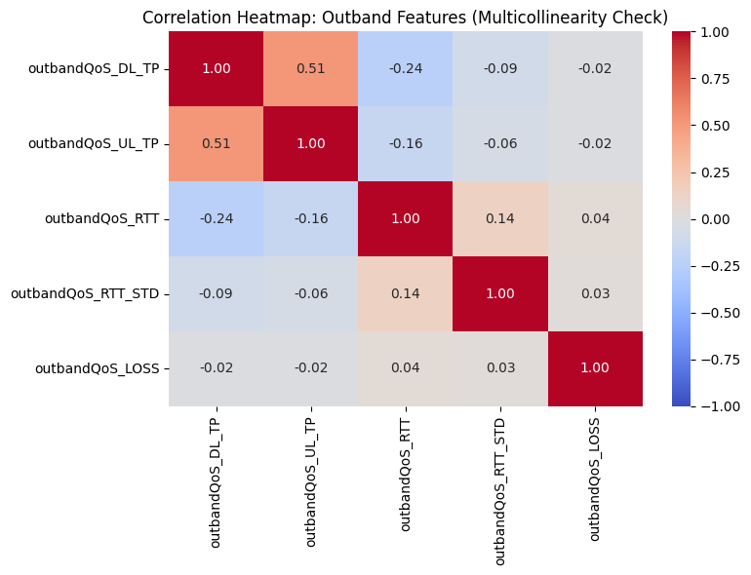
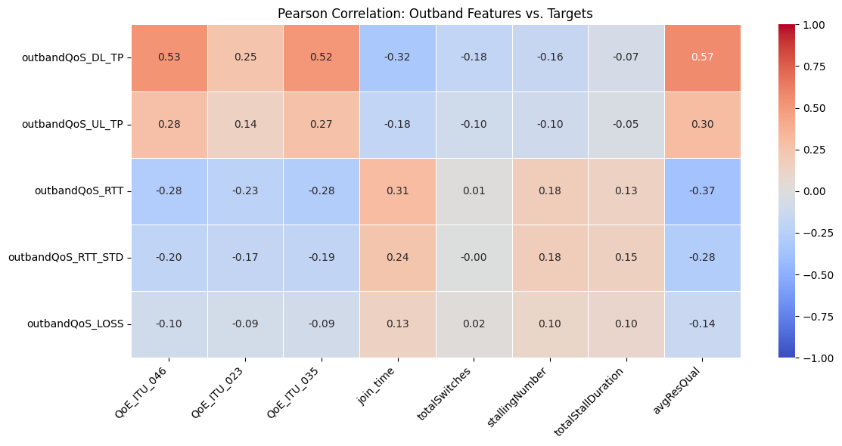
Data Exploration

Slide 7
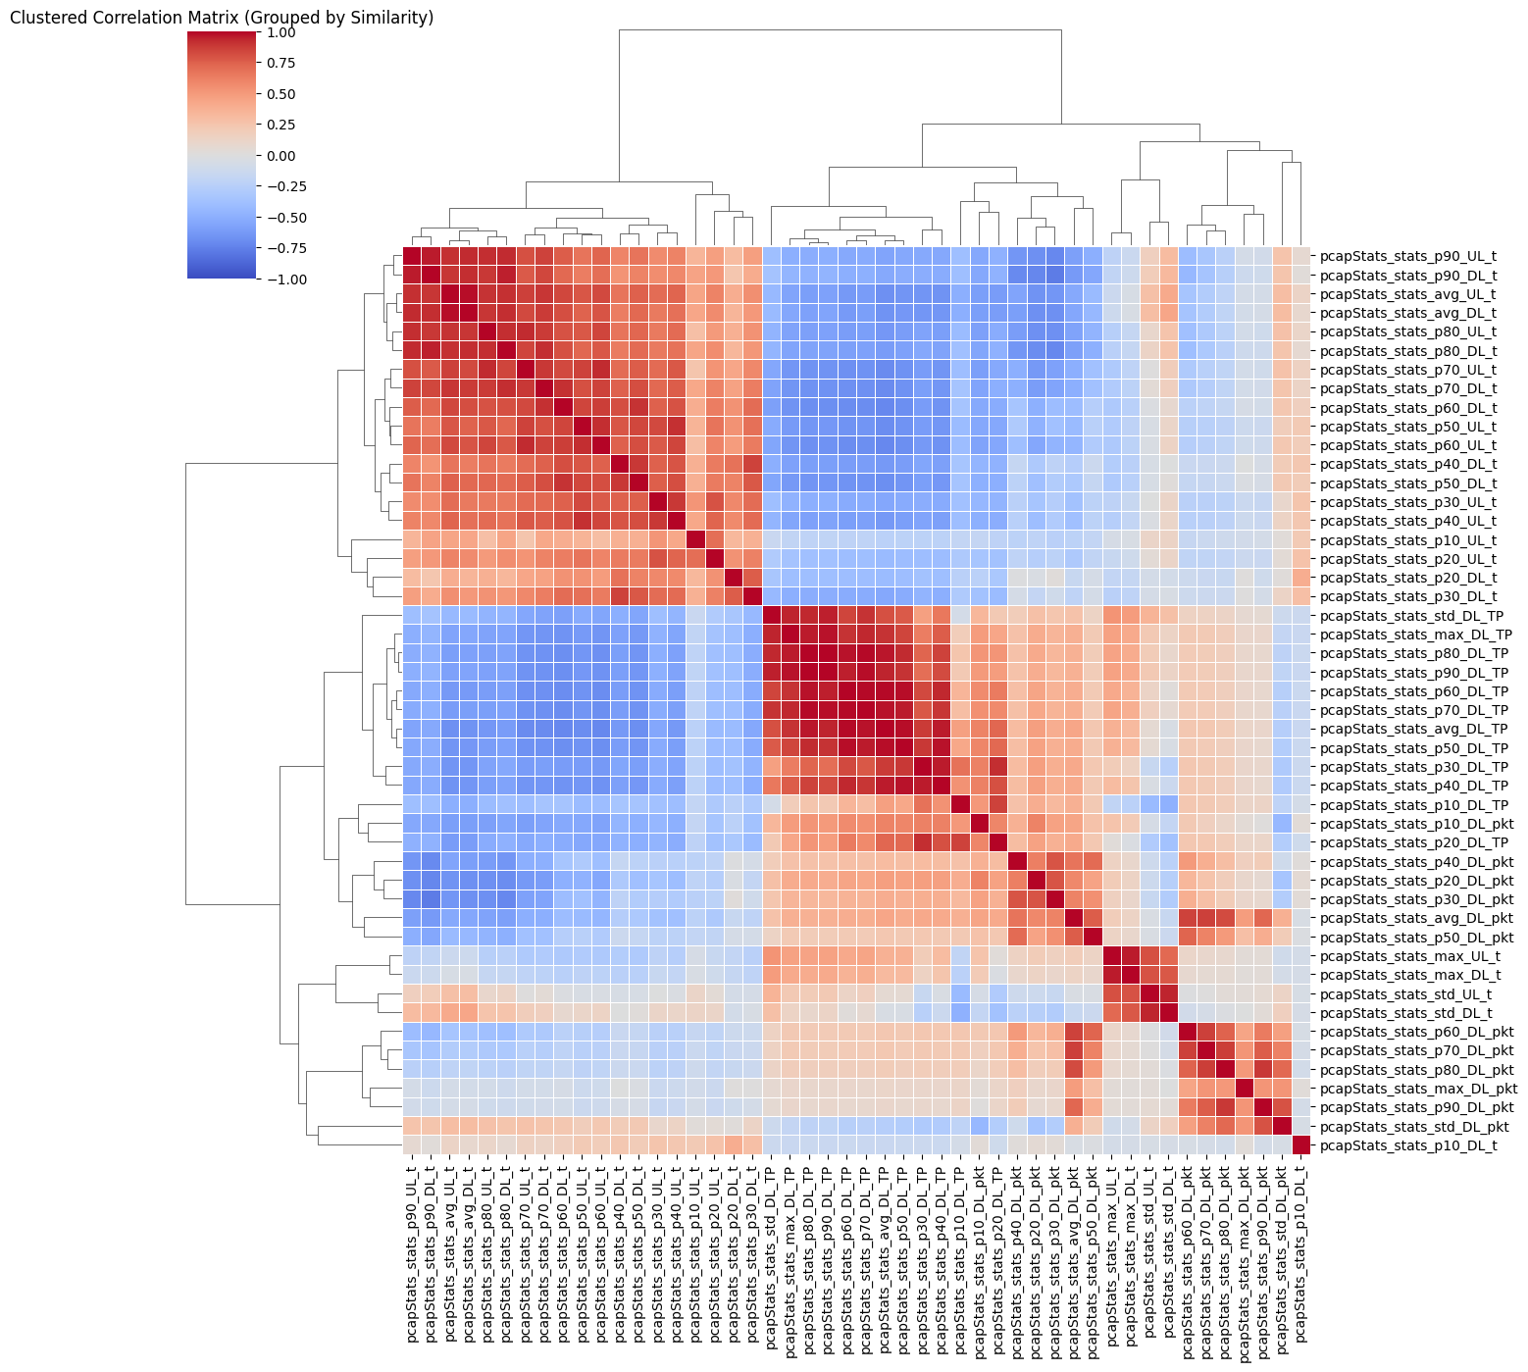
Data Exploration
Lots of feature have high collinear in F_inband
*_UL_t and *_DL_t (round trip time) features are heavily correlated
*_DL_TP (throughput) and *_DL_pkt (packet size) negative correlated to *_UL_t and *_DL_t
Form p30_DL_TP and up, these feature are effectively clones of each other => Redundancy?
The same applies for p60_DL_pkt and up, for std_UL_t and max_UL_t

Slide 8
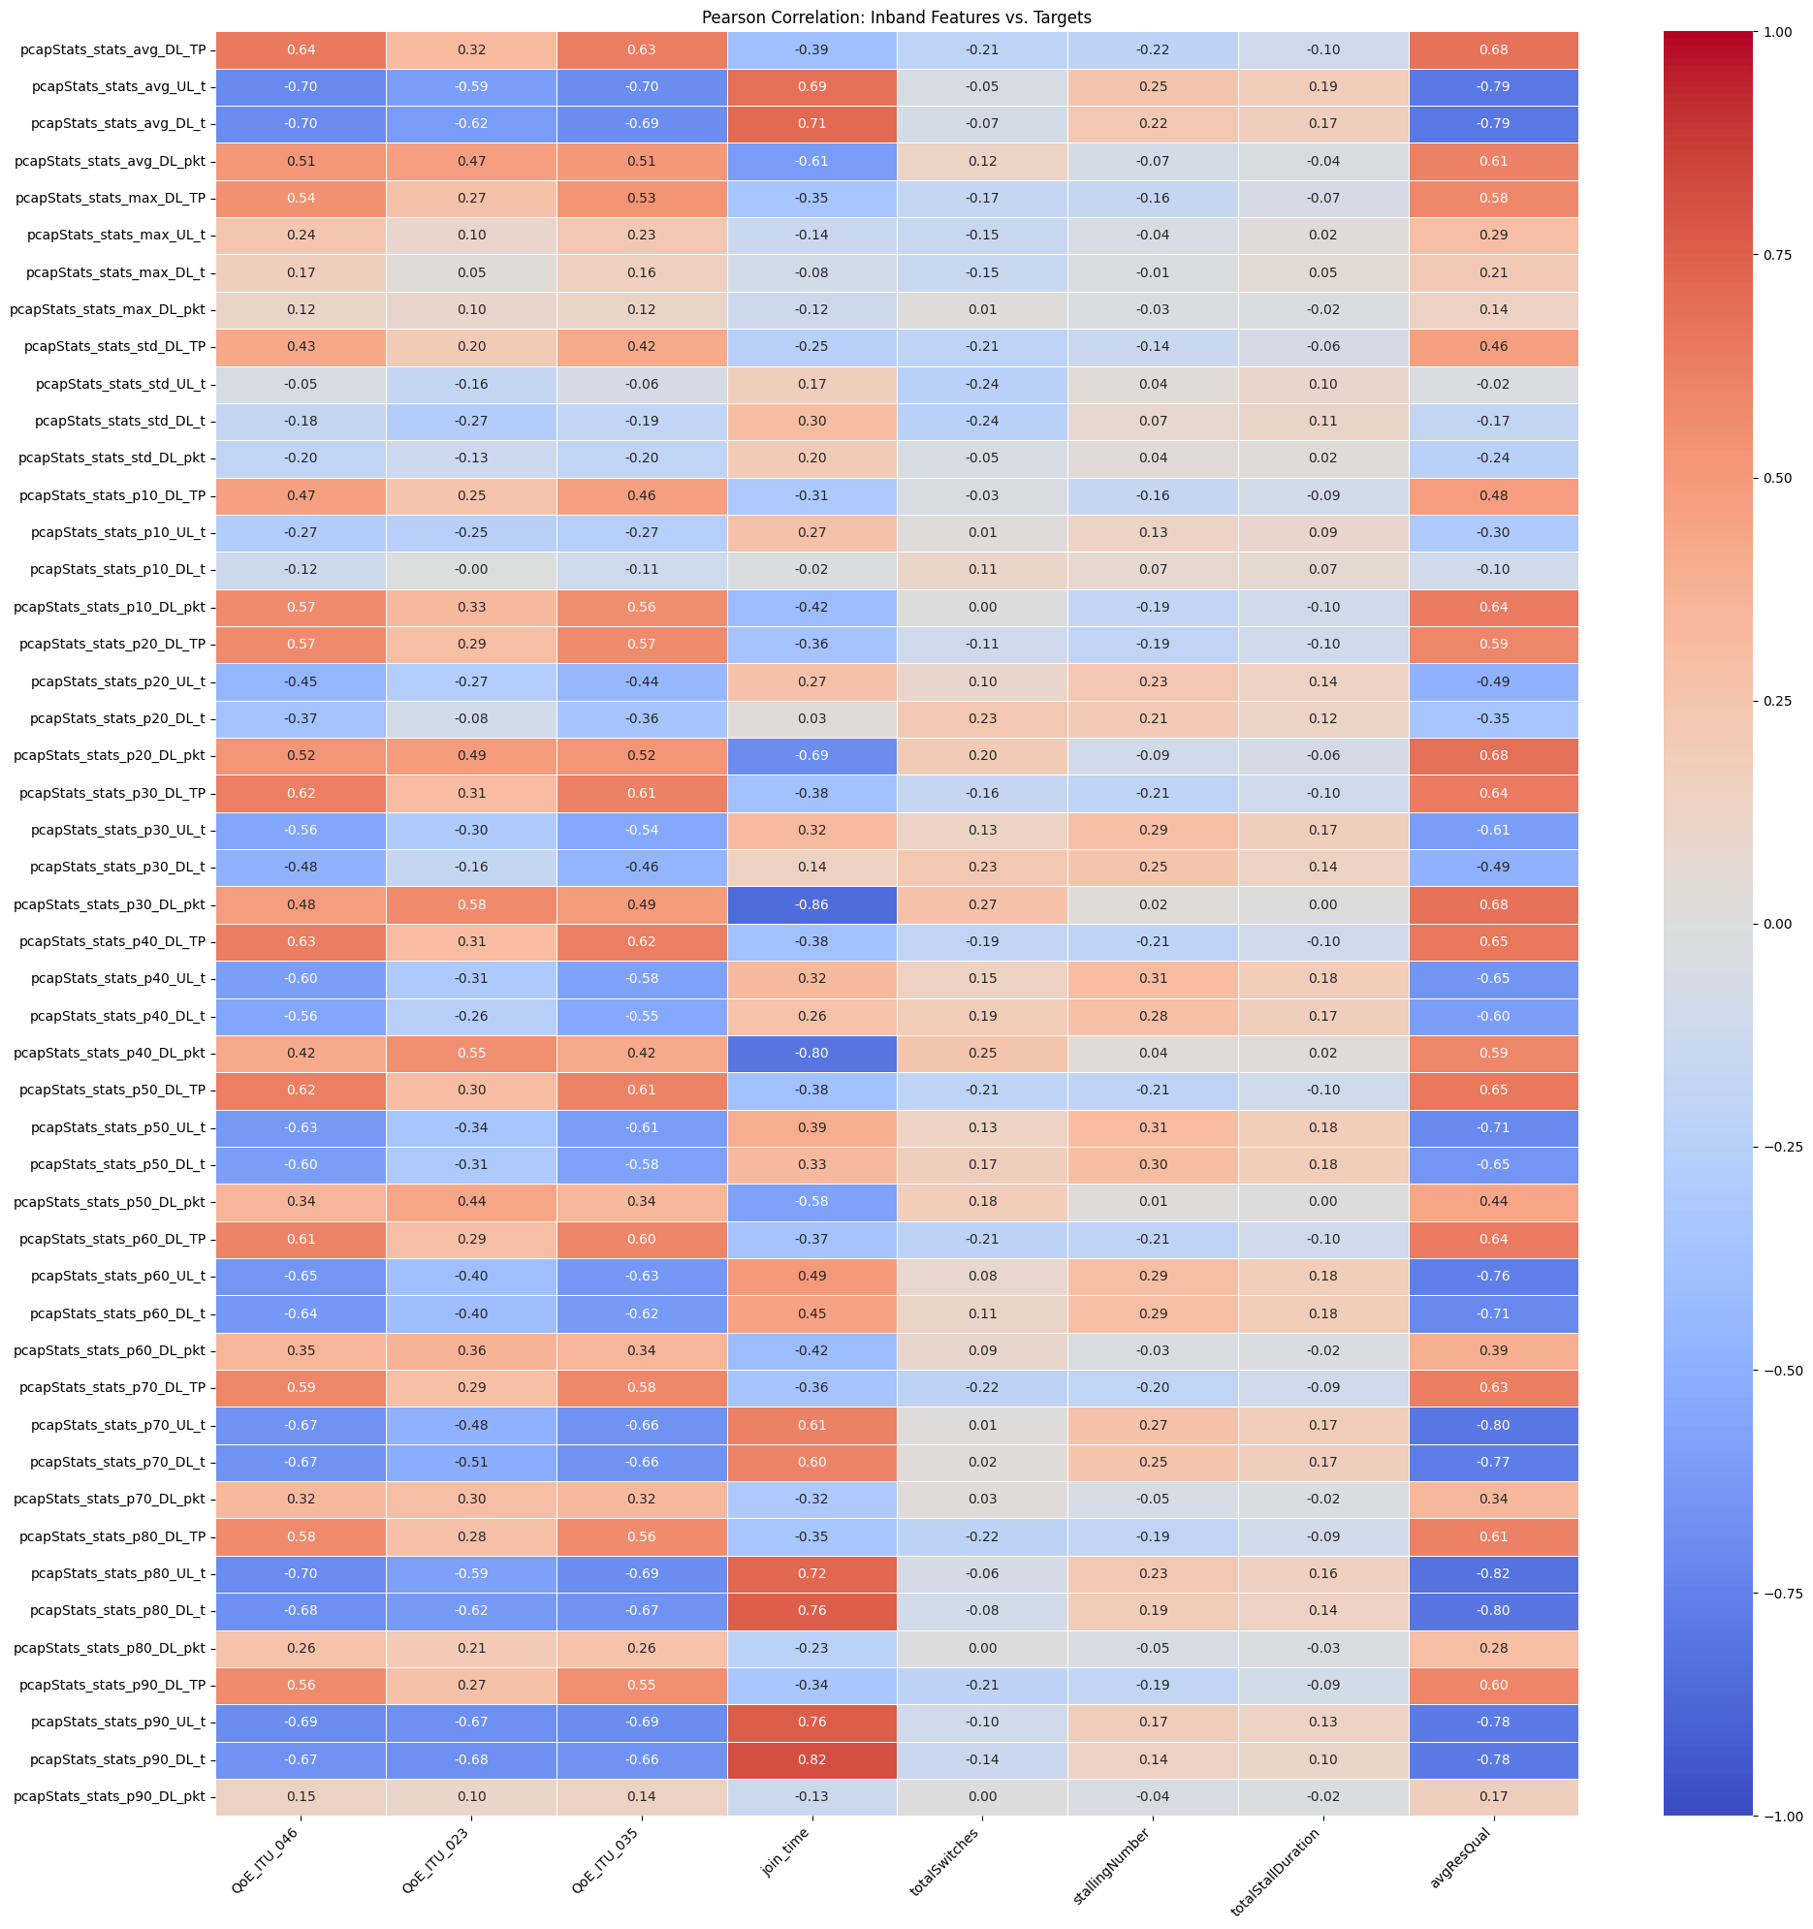
Data Exploration
In F_inband, round trip time of both upload and download affect the join time while packet size, download throughput affect the QoE and average resolution

Slide 9
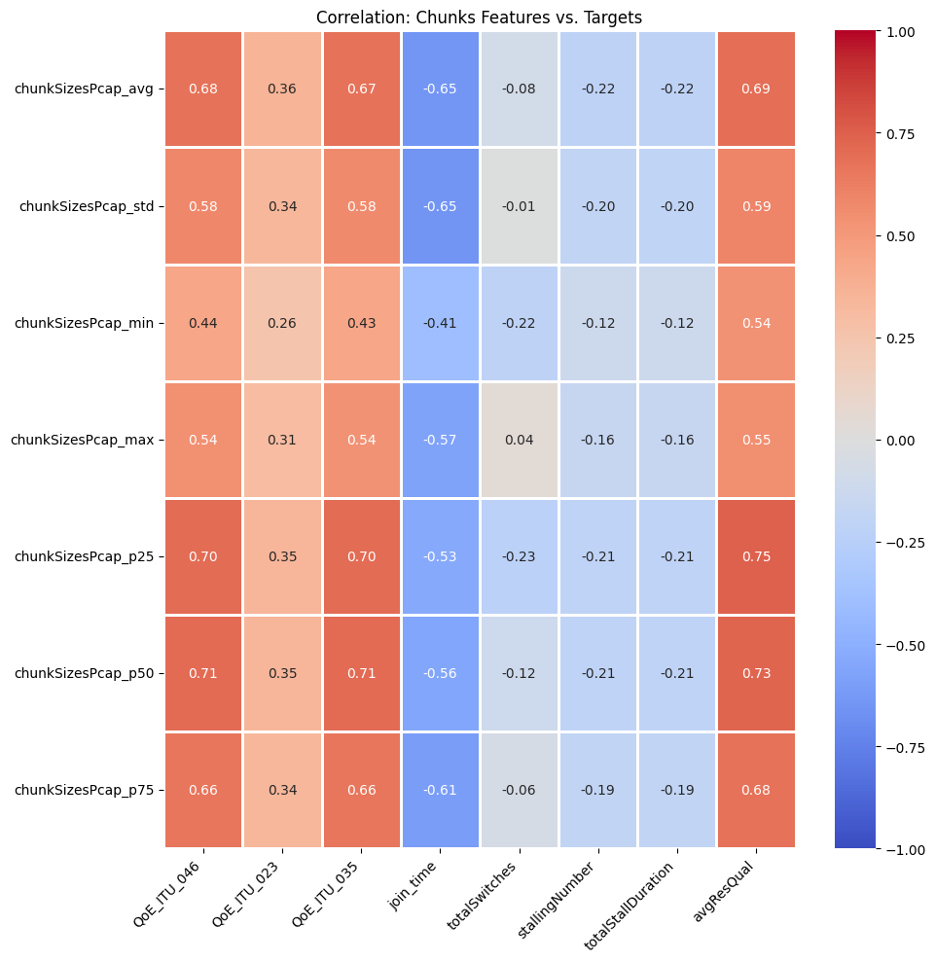
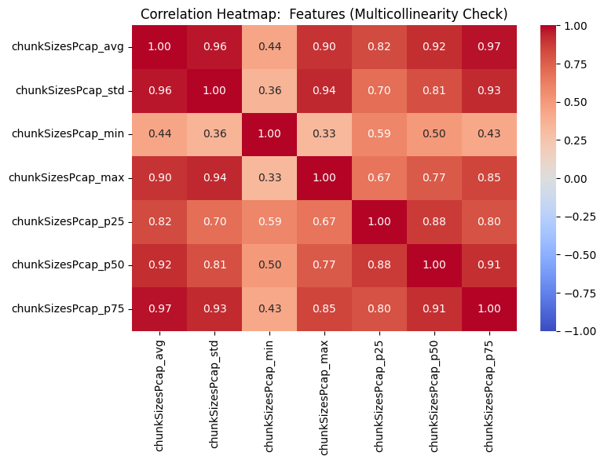
Data Exploration

Slide 10
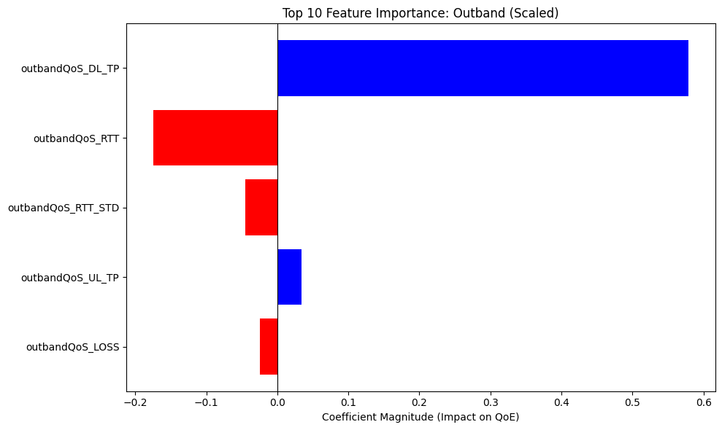
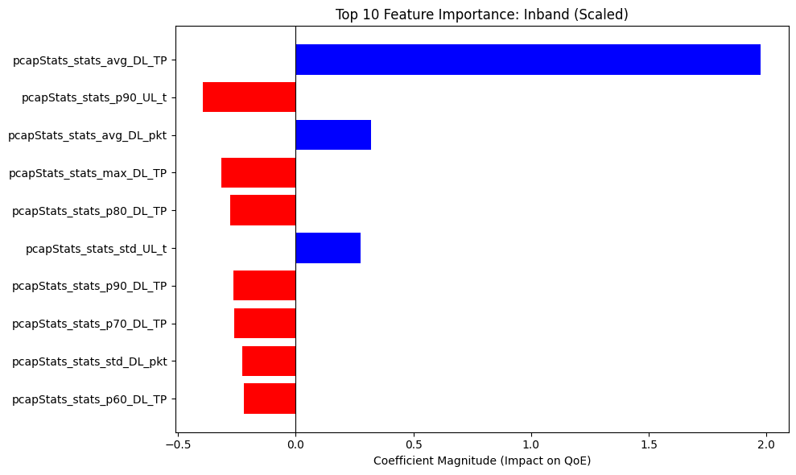
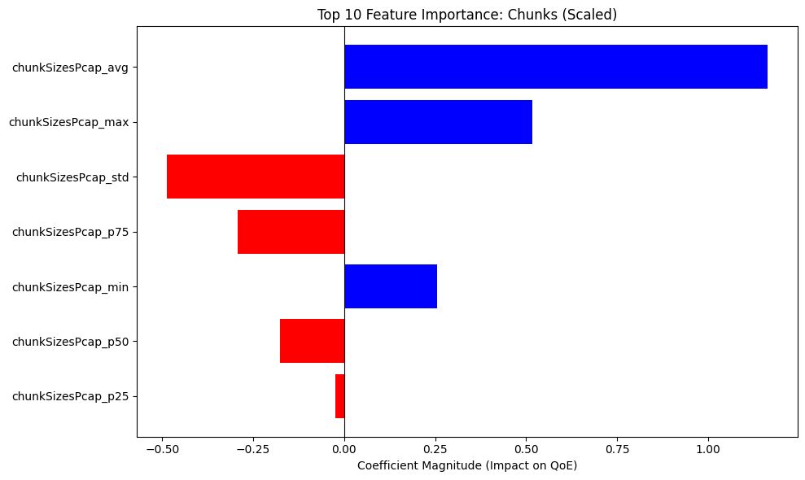
Linear Regression with Scaled Data
Non-Scaled MSE:
Outband : 1.04
Inband : 0.57
Chunks : 0.79
Scaled MSE:
Outband : 1.04
Inband : 0.57
Chunks : 0.78

Slide 11
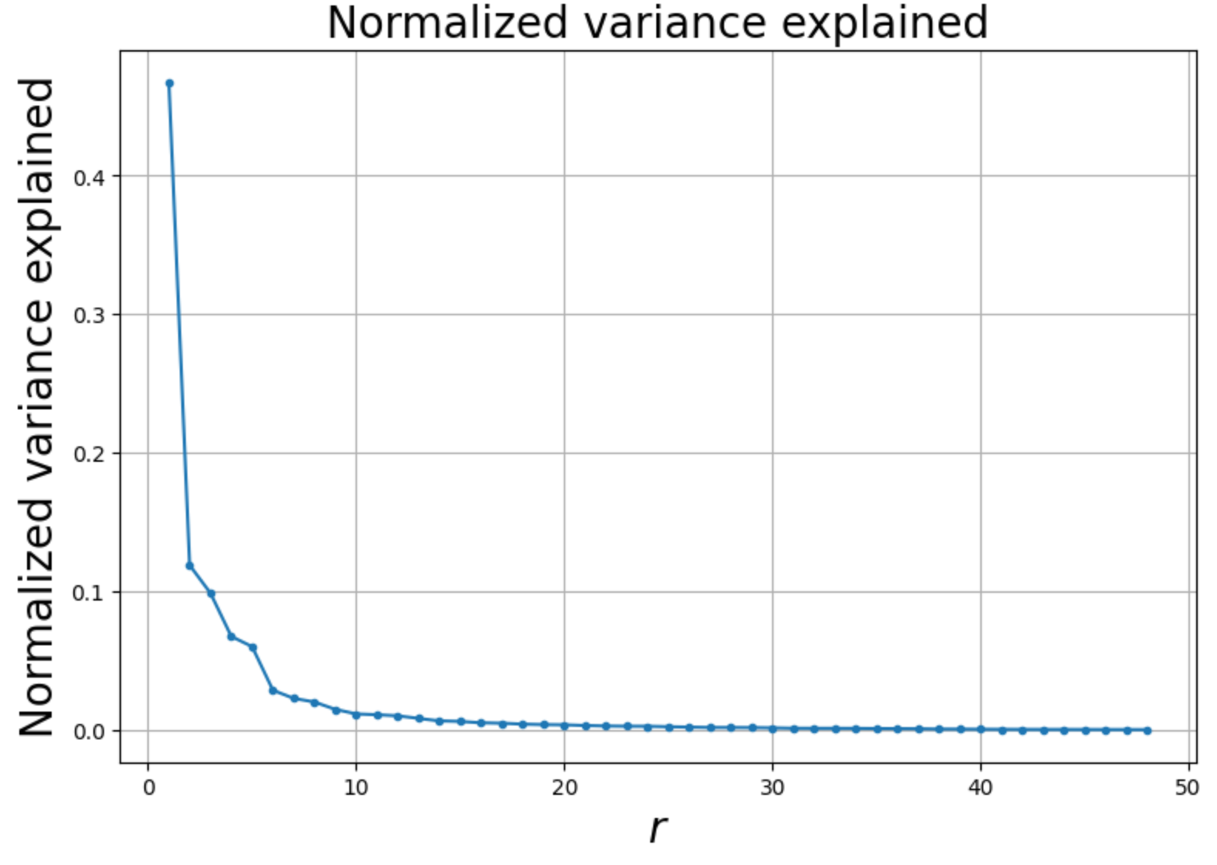
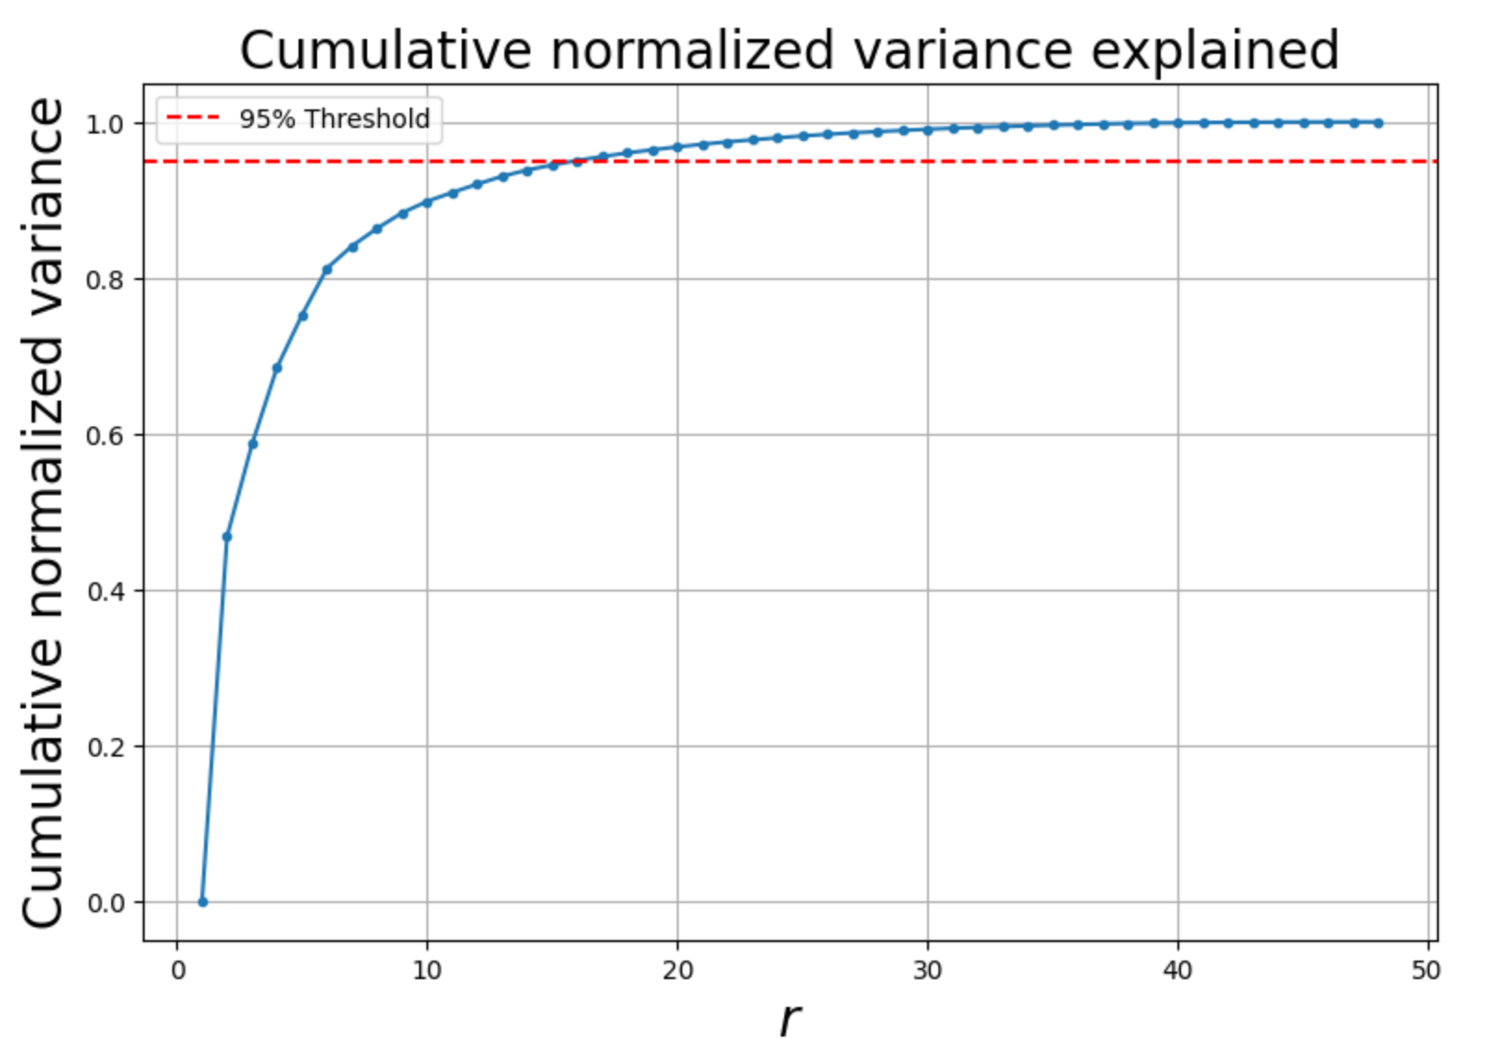
Dimensionality Reduction

Slide 12
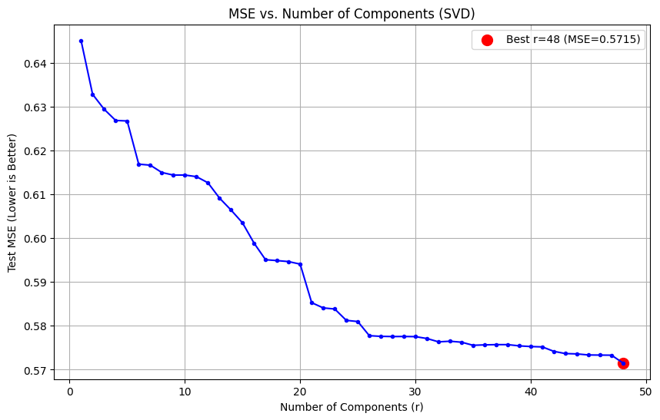
Dimensionality Reduction
F_inband full 48 features:
MSE: 5.5715
F_inband reduced to 30 features
MSE: 0.5775
Dimensionality Reduction is not useful in Linear Regression for F_inband features

Slide 13
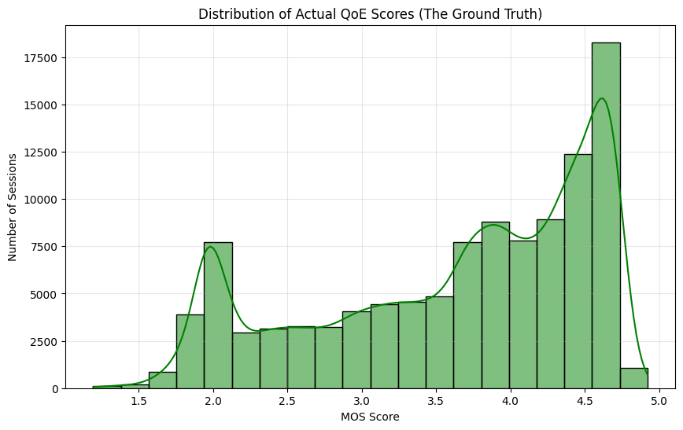
Data Exploration
Most of the ground truth QoE data are good QoE (4-5)
Average QoE Score: 3.6

Slide 14
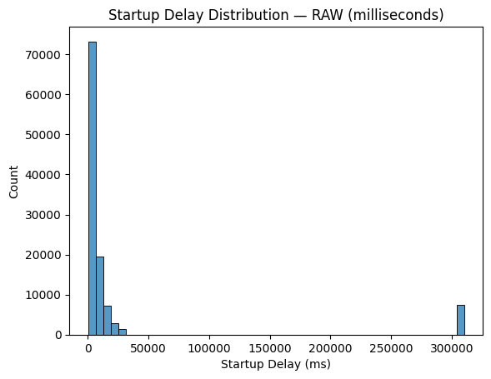
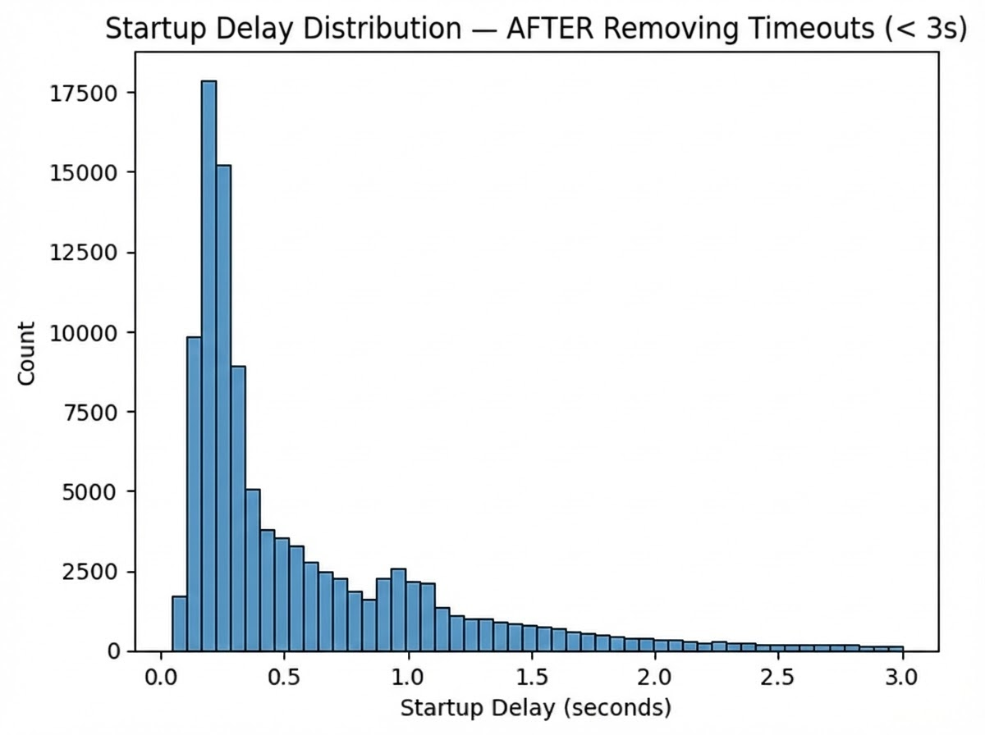
Data Exploration
Startup Delay
Key Takeaway: Timeouts are measurement artifacts and must be removed to model true startup delay.

Slide 15
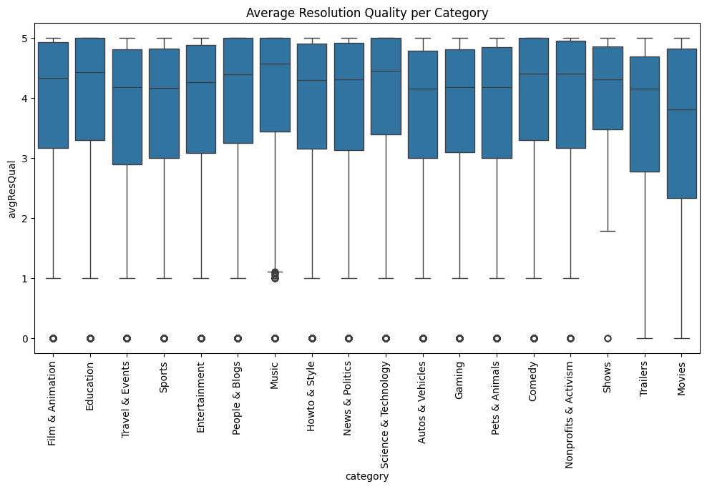
Data Exploration
Category of video does not affect the resolution

Slide 16
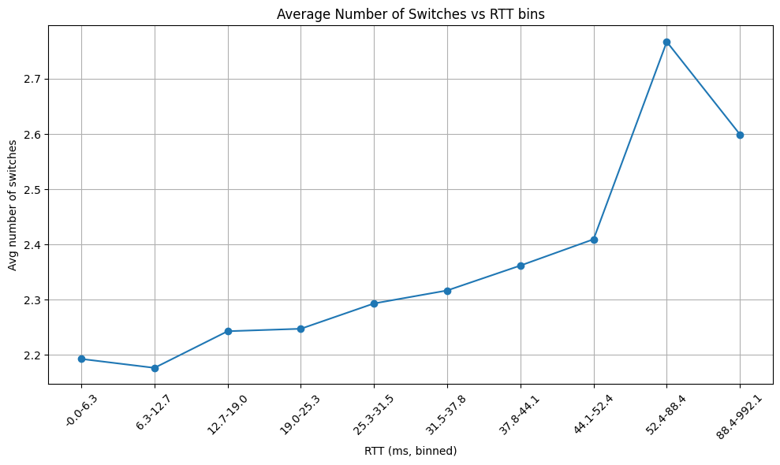
Data Exploration
Bin 52.4-88.4 is interesting:
Youtube specs
“midpoint” → too bad for high quality / too good for low quality

Slide 17
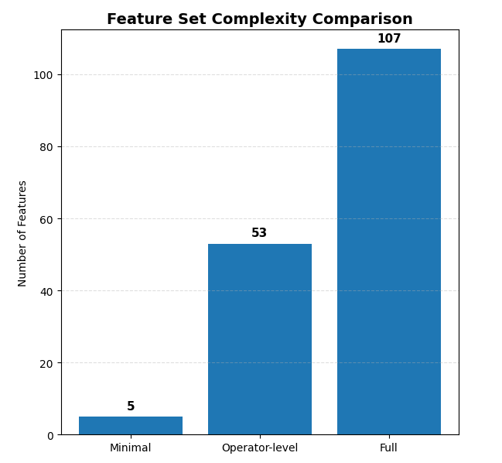
Feature Visibility Regimes - Definition
Three Feature Visibility Regimes
Minimal (Out-of-band QoS)
Network parameters measurable without deep packet inspection
RTT, bandwidth (DL/UL), packet loss; available to all operators
Ground truth QoS: Known in real life up to an error margin
Operator (Minimal + Encrypted Packet Statistics)
Adds packet-level metrics from encrypted traffic (pcapStats)
Observable despite encryption (timing, sizes, patterns)
Full (Operator + Inferred Chunk-level Features)
Requires advanced inference of application-layer metrics
Chunk sizes extracted via clustering

Slide 18
Stall Detection (Classification / anomaly detection)

Slide 19
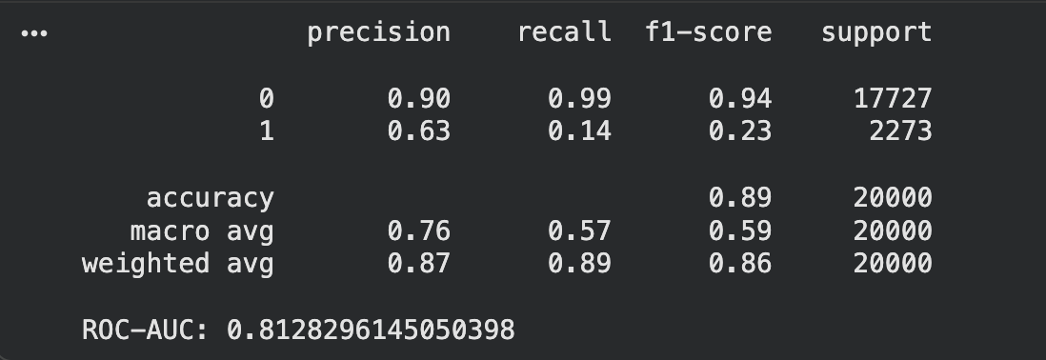
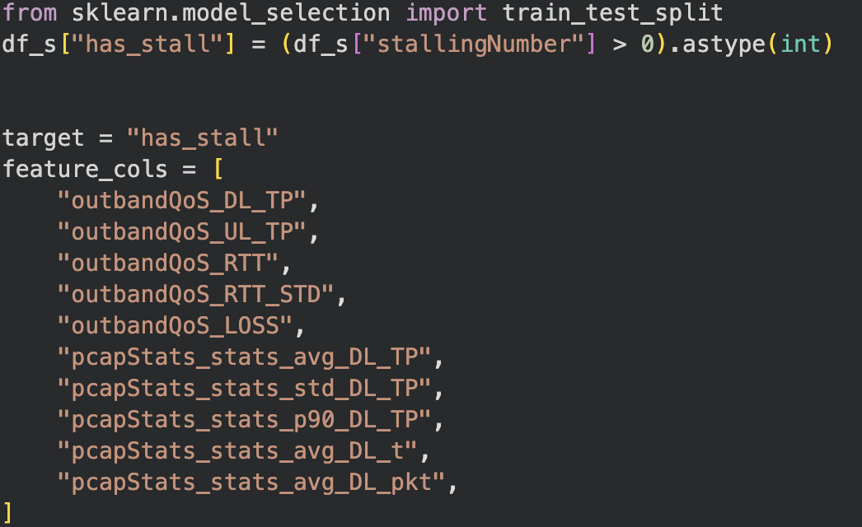
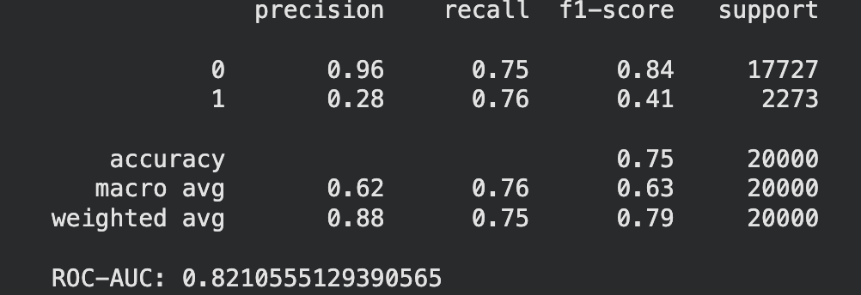
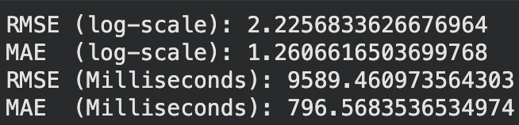
Stall Detection
used features
Random Forest:
(balanced db)
Feed-forward Neural Network:
(𝞰=0.001; 20 epochs; 2 hidden layers)
Stall duration:
Conclusion:
RF → bad recall
NN → bad precision
Stall duration: Not applicable
Random forest regressor (200 trees):
(applied log transformation)

Slide 20
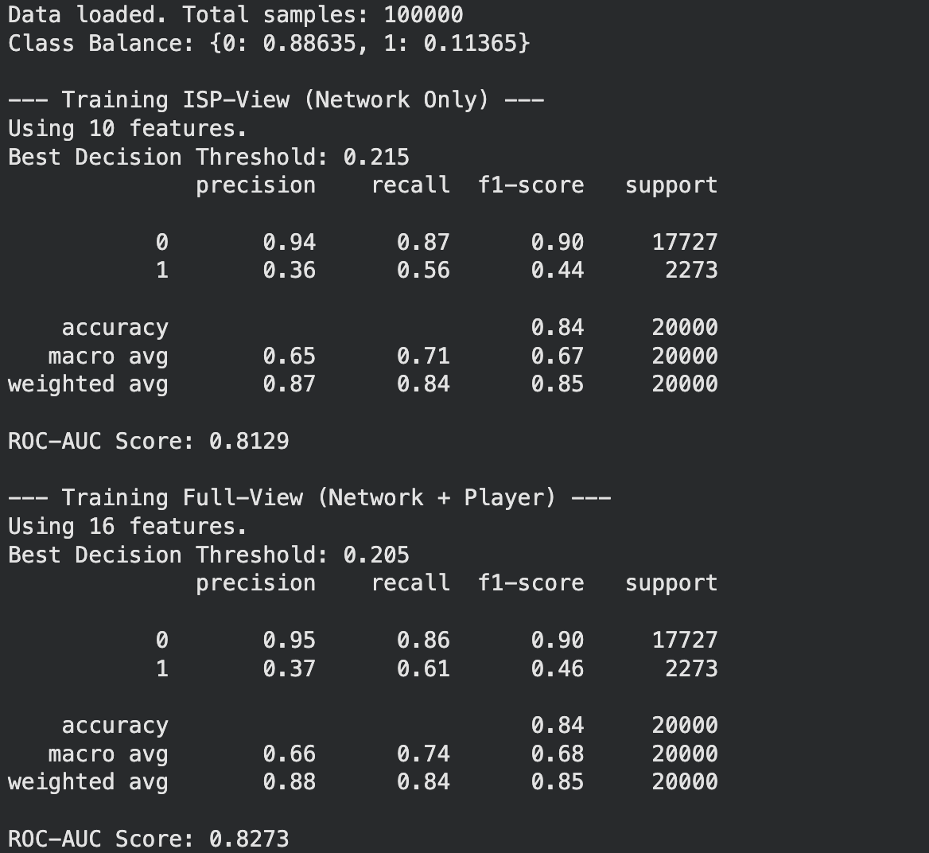
Stall Detection
Conclusion:
ISP view ⋍ Full view
Upgrades on model worked
F1-score is better than before

Slide 21
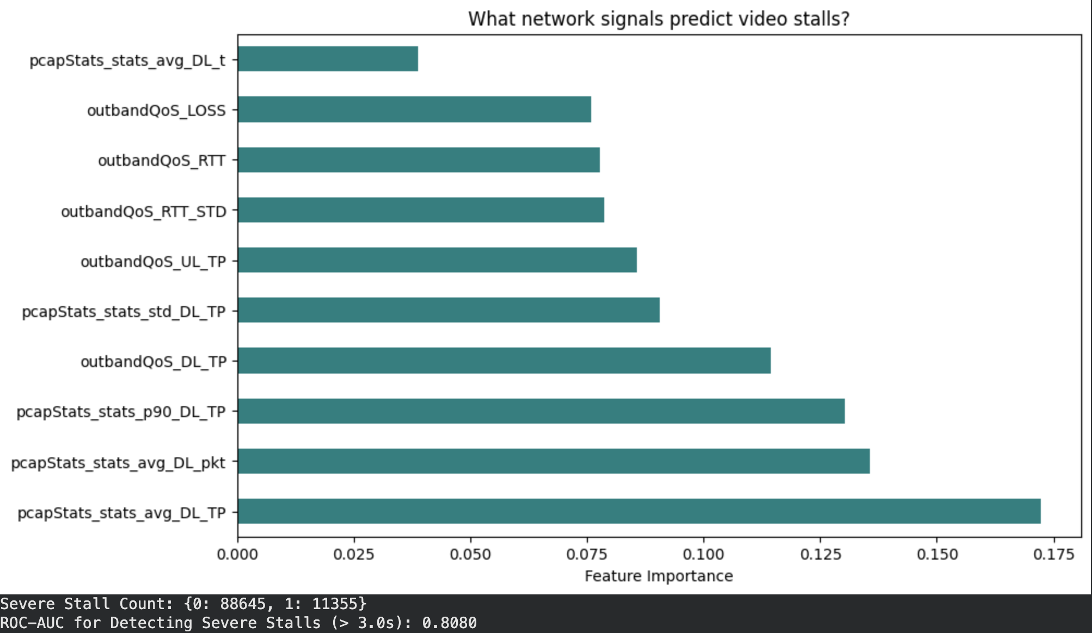
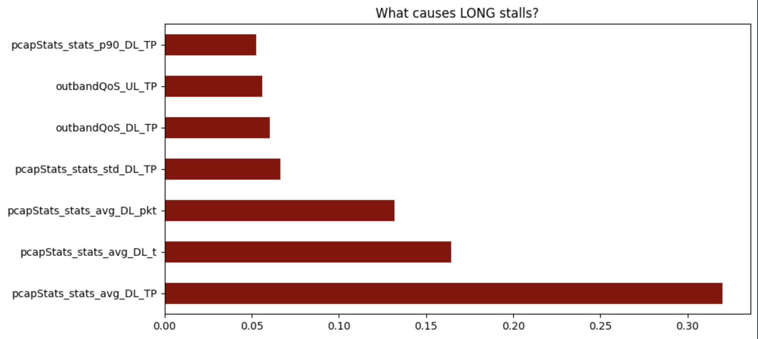
Stall Detection

Slide 22
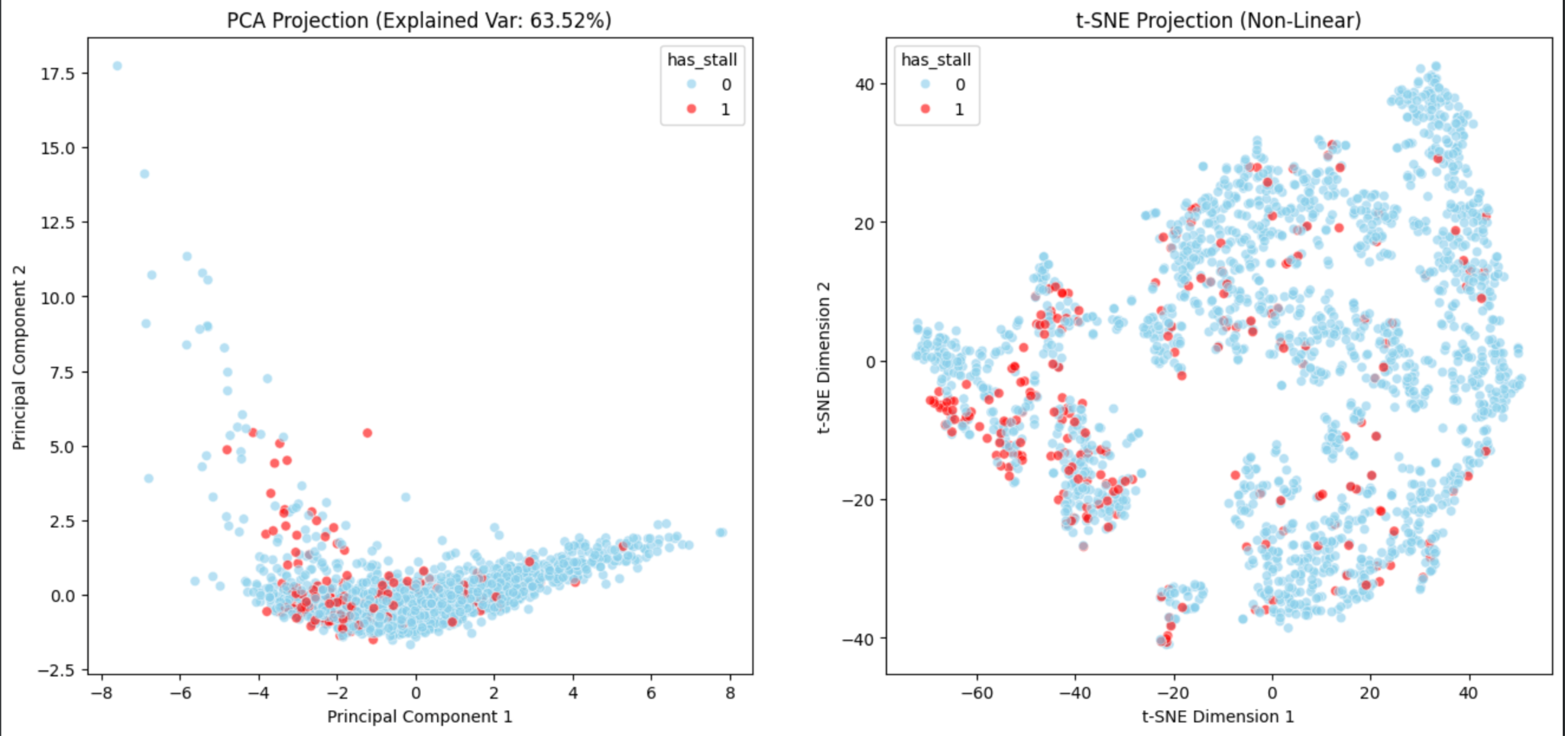
Stall Detection
Principal Component Analysis vs stochastic neighbor embedding
Conclusion:
Points are scattered → buffer health problems ?
Model can’t be a lot more precise than this

Slide 23
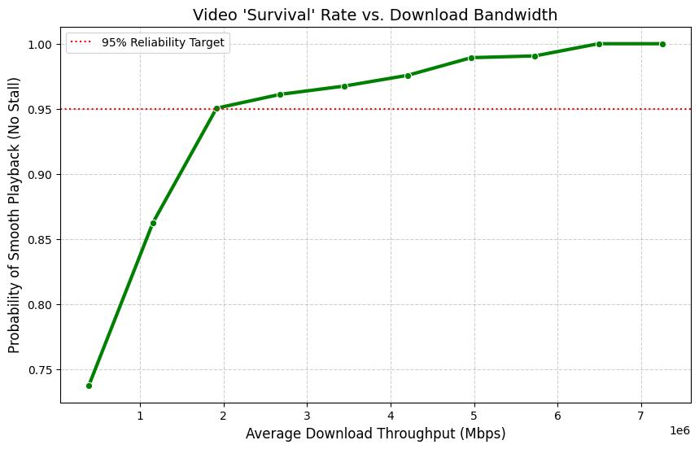
Stall Detection
Principal Component Analysis vs stochastic neighbor embedding

Slide 24
Startup Delay Classification (Timeout Detection)

Slide 25
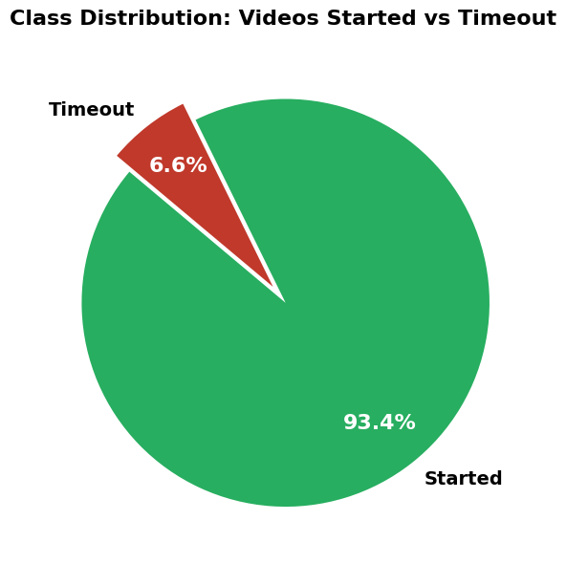
Startup Delay Classification (Timeout Detection) - Motivation
Problem Definition
Objective:
Detect whether a video session successfully starts or times out (never started)
The Critical Problem: Startup Delay
User Impact:
Users abandon videos if startup exceeds 2 seconds (Krishnan & Sitaraman, 2012)
Each +1s delay → +5.8% abandonment increase (same study)
First impression is everything (no second chance)
Expected Impact
Early detection (5-10s, not 30s) → Proactive intervention → Reduced churn

Slide 26
Random Forest Classifier & Cross-Validation Strategy
Why Random Forest for This Problem?
Advantages:
Handles non-linear relationships
Robust to class imbalance
Feature importance
Hyperparameters Selected:
RandomForestClassifier( n_estimators=50, # 50 trees for ensemble
max_depth=15, # Limit tree depth to prevent overfitting
min_samples_leaf=20, # Require 20 samples per leaf (statistical significance)
class_weight='balanced', # Automatic weighting: n_samples / (n_classes * n_class_samples)
random_state=42 # Reproducibility)
Handling Class Imbalance:
1. Stratified Sampling
Maintains 93.4% / 6.6% ratio in train/test splits
Prevents model from never seeing minority class in validation
2. Class Weighting (class_weight='balanced')
Automatically adjusts loss function
Equivalent to inverse frequency weighting
Cross-Validation Strategy (5-Fold Stratified Cross-Validation)
Why Stratified?
Each fold maintains the 93.4% / 6.6% class distribution
Critical for imbalanced data (regular K-fold could create folds with few/no timeouts)
Ensures every fold is representative of the full dataset

Slide 27
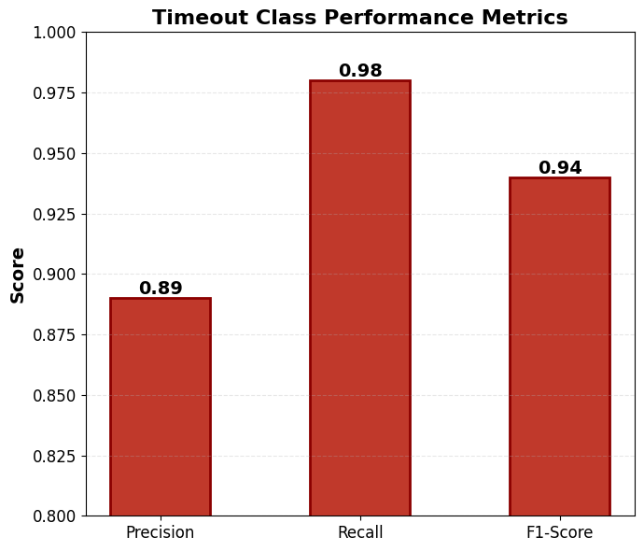
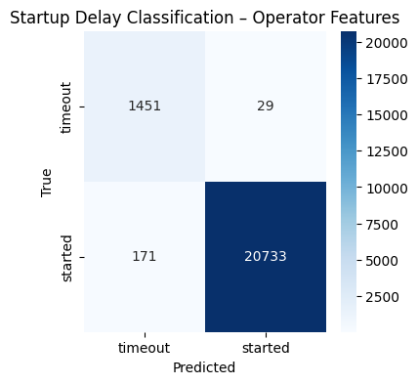
Feature Visibility Regimes - Operator Features Results
Classification Report
Key Insight: Operator-level network features are sufficient for near-perfect timeout detection.

Slide 28
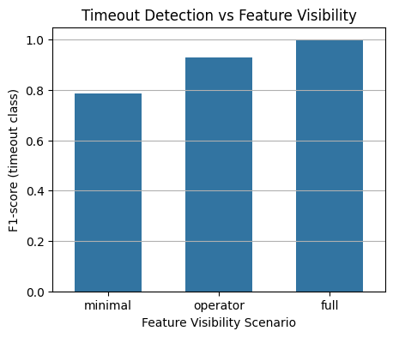
Feature Visibility Comparison - Timeout Detection
Performance Across Feature Sets
F1-score by feature visibility
Minimal: ~0.78
Operator: ~0.89
Full: ~0.90
Key Takeaway: Operator-level features achieve near-optimal performance with minimal added complexity.

Slide 29
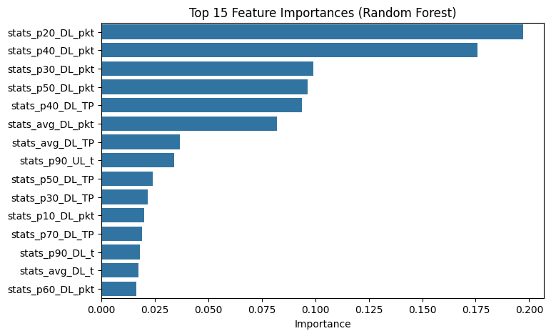
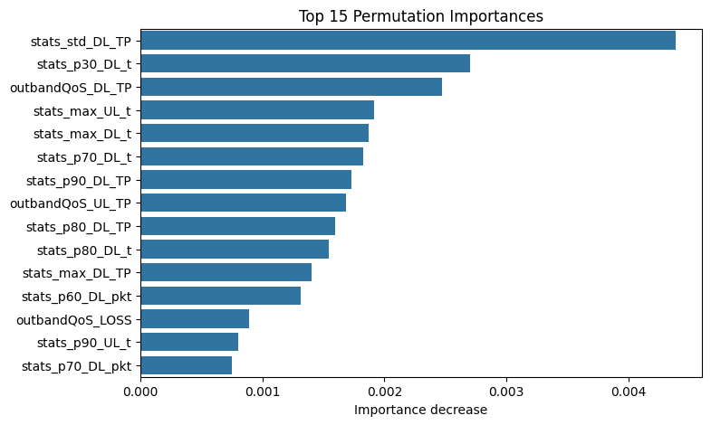
Feature Importance Analysis
Key Takeaway: Startup delay is a bandwidth-limited phenomenon: poor downlink conditions dominate user-perceived startup time.

Slide 30
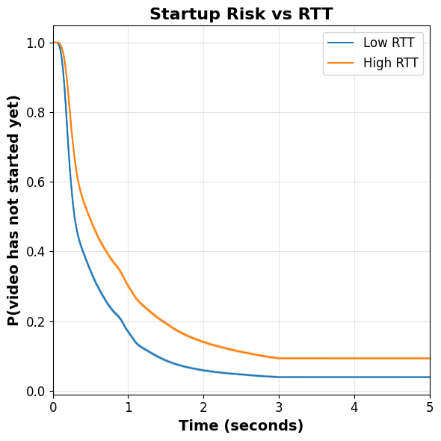
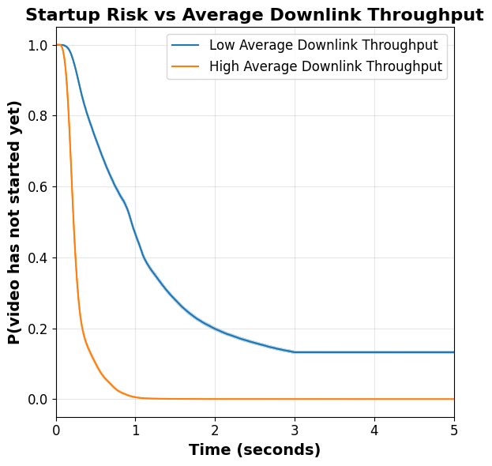
Survival Analysis - Network Conditions & Startup Risk
Average Downlink Throughput / RTT
Key Takeaway : Startup success is dominated by bandwidth first, latency second : poor network conditions keep videos at risk far longer.

Slide 31
Startup Delay Prediction

Slide 32
Startup Delay Prediction - Problem Definition & Data Quality
The Prediction Task
Objective:
Predict continuous startup delay (in seconds) for video sessions
Why This Matters:
Complements classification (will it timeout?) with quantitative prediction
Enables precise resource allocation (know exactly how much delay to expect)
Users abandon after >2 seconds — every second counts (Krishnan & Sitaraman, 2012)

Slide 33
Regression Model & Experimental Design
Models
Linear Regression
Log-Linear Regression
Random Forest
Validation
5-fold cross-validation
Metric: RMSE (seconds)

Slide 34
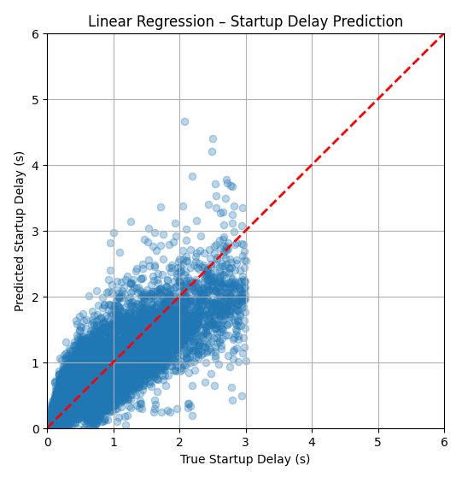
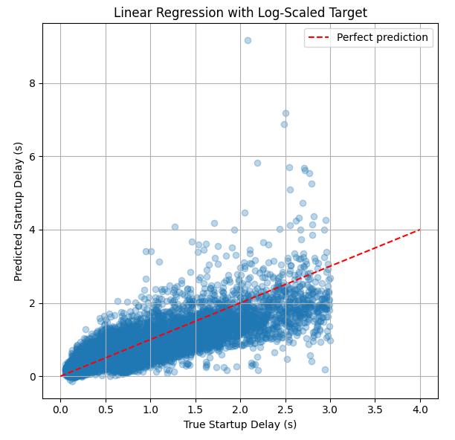
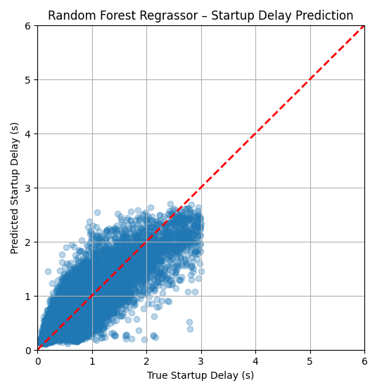
Startup Delay Prediction
Model Performance Comparison: Linear vs. Tree-Based
Key Takeaway : Tree-based models best capture startup delay, while linear models struggle with long-delay behavior.

Slide 35
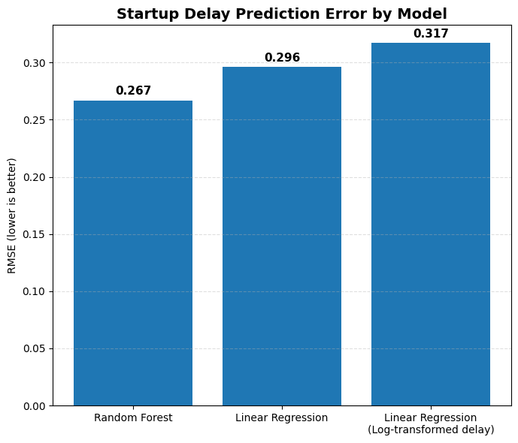
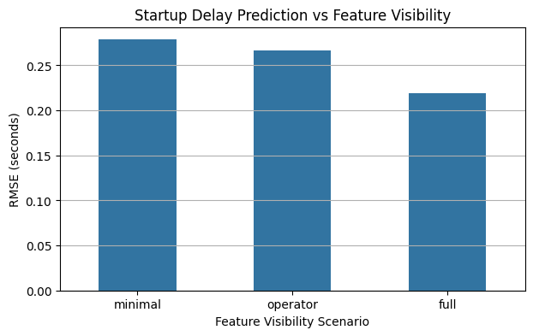
Model Performance & Feature Set Comparison
Random Forest wins: 0.267s RMSE vs. 0.296s (linear) and 0.317s (log-linear). Non-linearity matters.
Diminishing returns: Full features only 18% better than minimal. Basic QoS surprisingly strong.

Slide 36
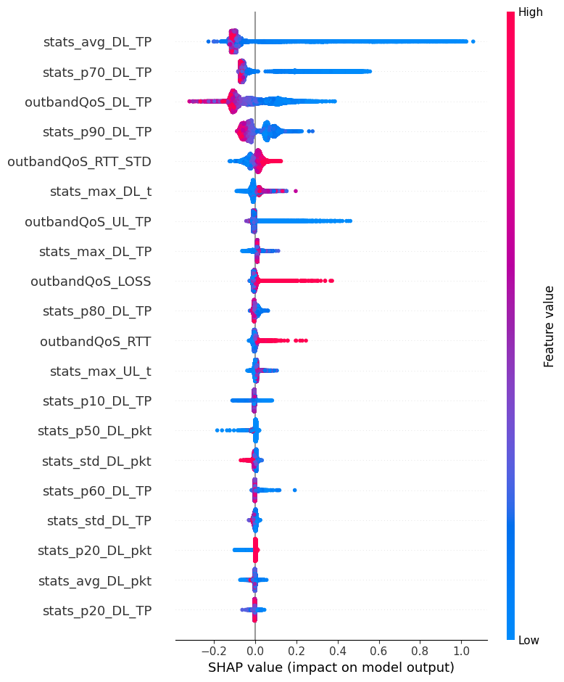
Random Forest Model Interpretability
Coefficients vs. SHAP
Key Insights
Startup delay is driven by bandwidth regimes
Throughput tail behavior matter as much as averages
Latency and loss act as amplifiers under degraded conditions
Uplink effects are secondary but non-negligible
Key Takeaway
Startup delay emerges from non-linear interactions between bandwidth level, variability, and network degradation.

Slide 37
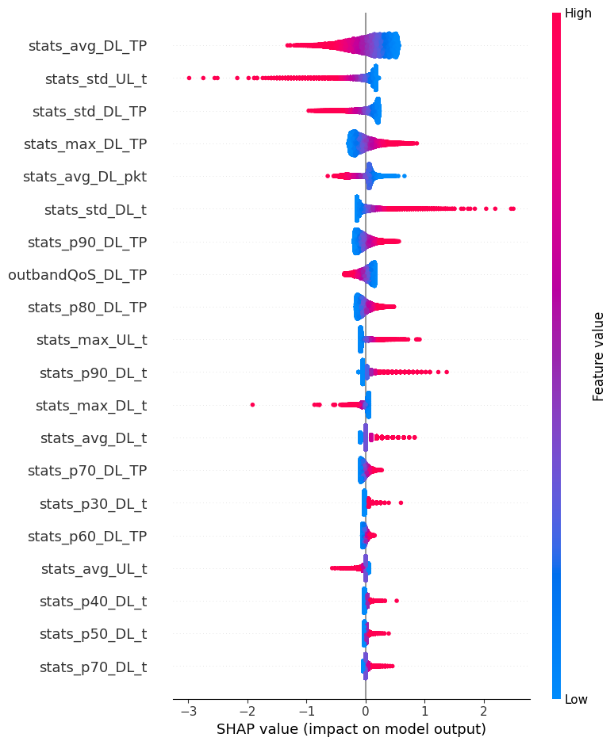
Linear Model Interpretability
Coefficients vs. SHAP
Key Insights
Average downlink throughput is the dominant driver of startup delay.
Variability in throughput and delay matters, not just mean values.
Extreme values disproportionately influence predictions.
Effects are monotonic and additive, with no regime-dependent behavior.
Key Takeaway
The linear model explains startup delay mainly through average bandwidth and variability, but is dominated by extreme values and lacks interaction awareness.

Slide 38
QoE Score
Prediction

Slide 39
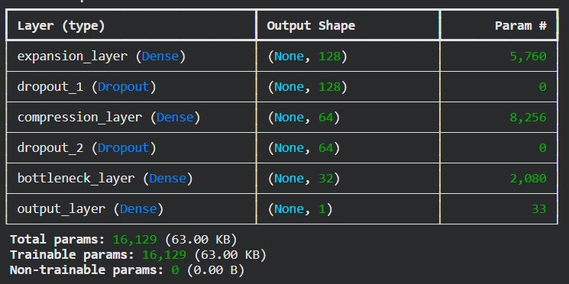
Neural Network Architecture
Scaled dataset
Neural Network with 3 hidden layer
Activation function: ReLU
Feature sets used:
F_inband with high correlated features removed
F_outband: all features
Adamm, learning rate = 0.001, batch_size= 32
MSE for loss function
Linear regression with the same dataset:
MSE: 0.5702
RMSE: 0.7551
MAE: 0.5175

Slide 40
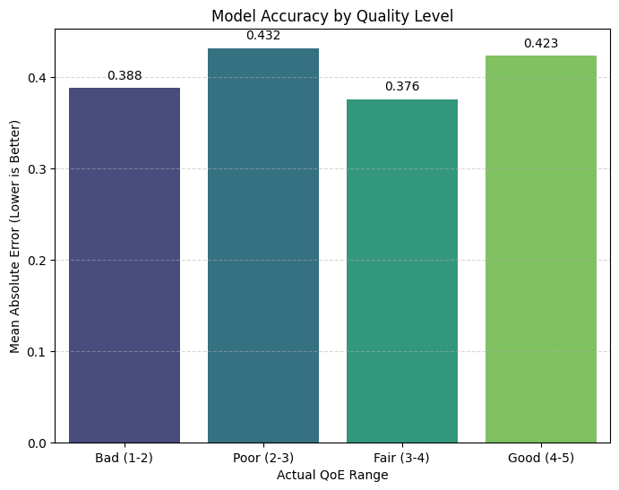
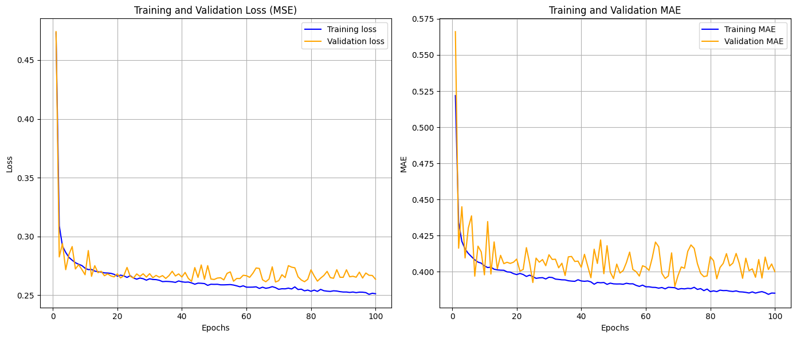
Model Performance
Test Set Evaluation
Test MSE: 0.2732
Test MAE: 0.4075
Test RMSE: 0.5227
K-fold (5 fold):
Average MSE: 0.2625 (+/- 0.0048)
Average MAE: 0.3970 (+/- 0.0044)
Average RMSE: 0.5124 (+/- 0.0047)

Slide 41
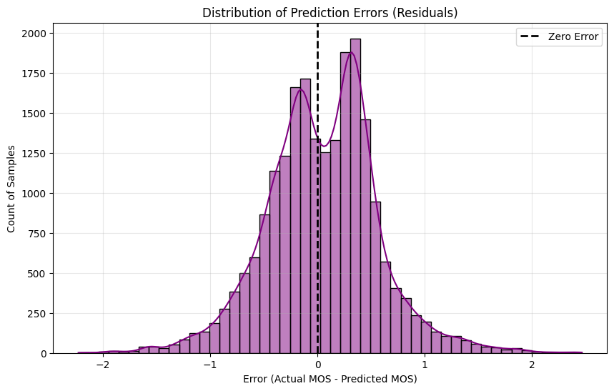
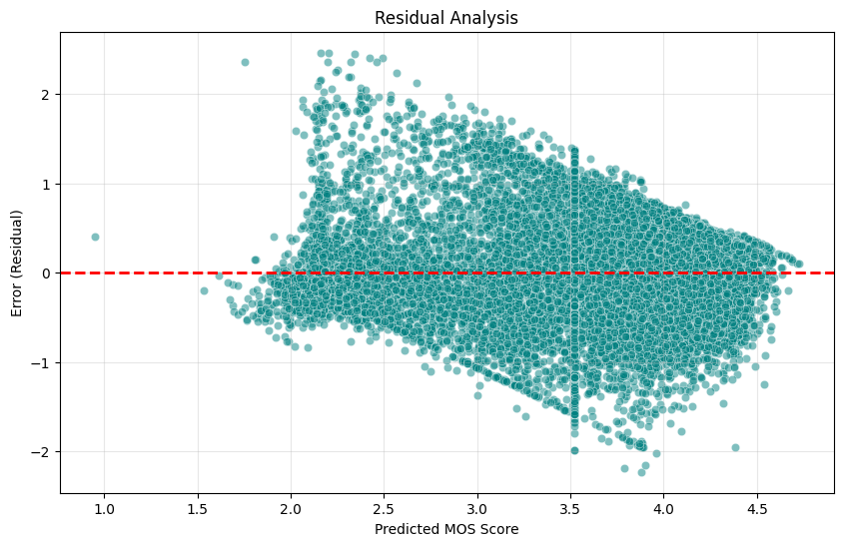
Model Performance
The model tends to underestimate actual low MOS and overestimate actual real MOS

Slide 42
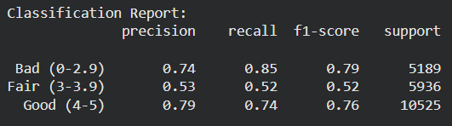
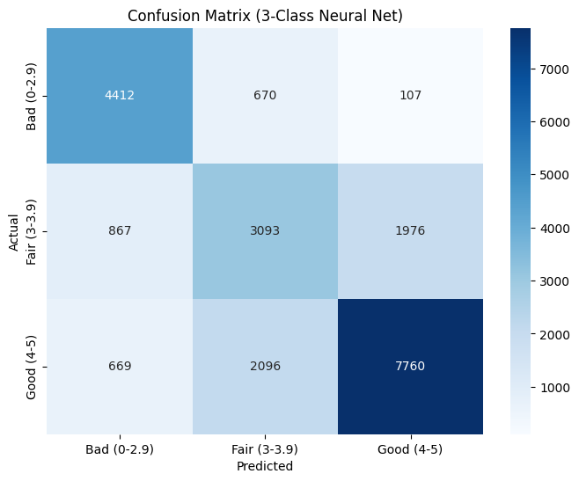

MOS Classification: Neural Network
The model still confuses between Fair and Good

Slide 43



MOS Classification: XGBoost
Slightly better than Neural Network

Slide 44
THANK YOU !

Slide 45


ITU-T P.1203
Standardized algorithmic model used to measure QoE
P.1203.1 for Video and P.1203.2 for Audio
P.1203.3: combine the scores and other factor (stalls, quality switch) for overall MOS
Video stream data is ran through the algorithm.
Reads metadatas, frame header, bitstream, etc.

Slide 46

Data Exploration

Slide 47


Model Performance
With MAE as loss function, the problem still occurs
Test MSE: 0.4168
Test MAE: 0.4168
Test RMSE: 0.5875

